Slide 1

Title
Neighbour grocer
your nearby grocery at one place
Developers - Peavershi mishra Palkesh Dharmik Kanchan Pal

Slide 2
Introduction to project
Neighbour grocer is E commerce website which help user to get all grocery shops nearby user location.
In neighbour grocer user can select the seller shop from where he want.
To buy his stuff the list or product details along with user location will directly sent to shop owner and user can get fast delivery and can buy from his trusted shop.
E

Slide 3
Main concept
The main idea behind this project was to increase the sell of local area grocer and provide user fastest and trusted service

Slide 4
Features of project
Efficient product search
Consistent online and in-store product information
Add shopping list items and send to seller
Frictionless checkout
Click-and-collect and home delivery fulfillment options
Buy from your local sellers.

Slide 5
Some of
Project screenshots
...

Slide 6
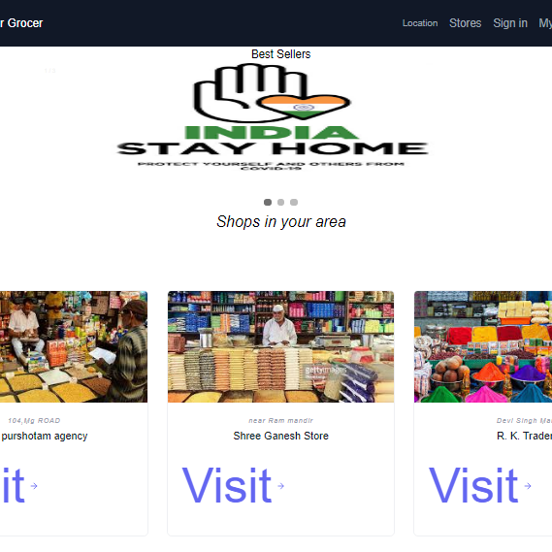
Home page.
Our home page is the first page user will visit as soon as he reaches to website
Home page consist of three different parts
Navbar
Bestsellers image.
Shops in user city.

Slide 7
Home page

Slide 9
Home page- 1. Navbar
Navbar include Location, stores Sign-in , search and mylist functions which perform different tasks

Slide 10
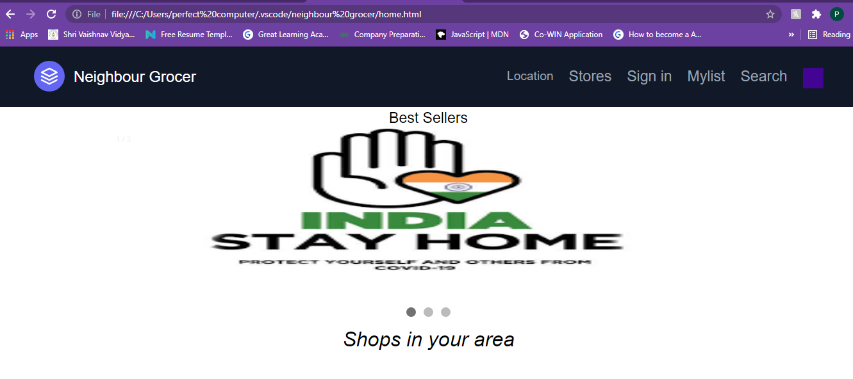
Home page first look-2.bestseller

Slide 11
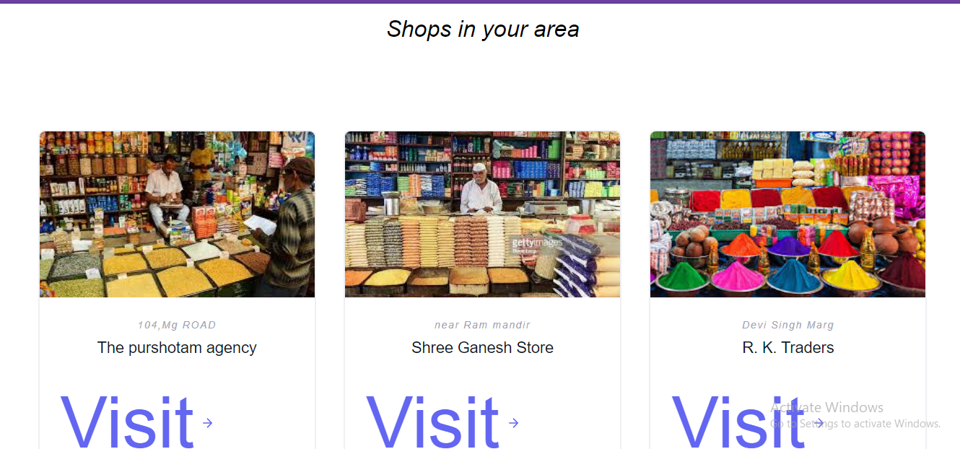
Second part of home screen shop in area

Slide 12
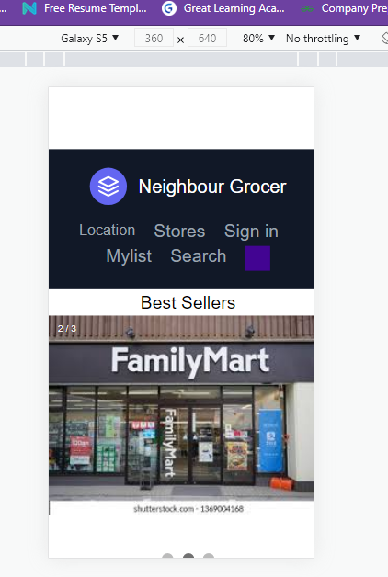
As it is responsive website with phone can be looked as.

Slide 13
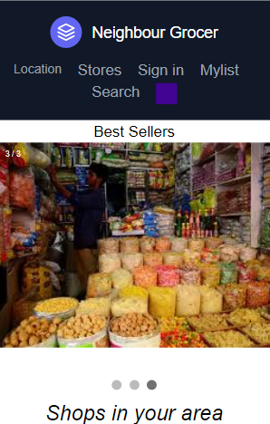
Tablet project
.

Slide 14
1. location
by clicking on location user current location will be appearing on page.

Slide 15
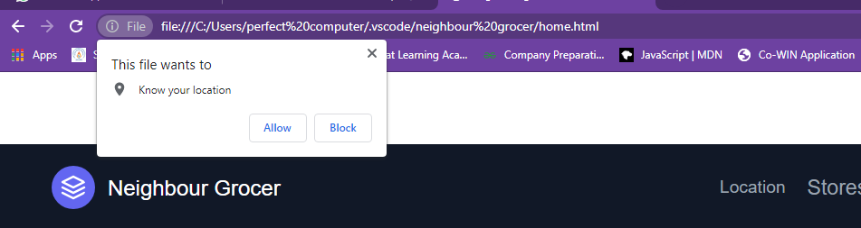
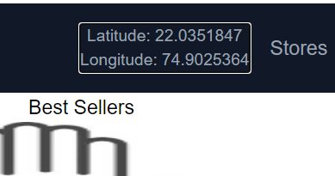
Location page.

Slide 16
2. Stores
By visiting this page user can visit the shops around him

Slide 17
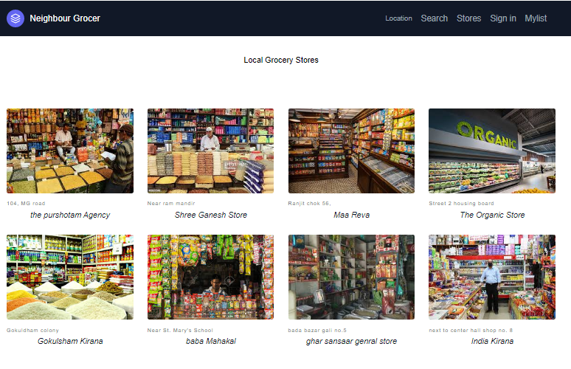

Slide 18
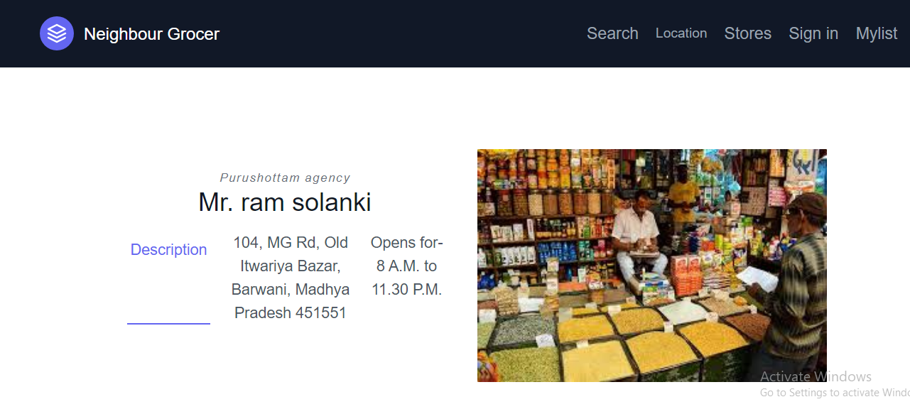
Shop page

Slide 19
3. Sign-in
By visiting this page user can easily sign in with us and save all his data

Slide 20
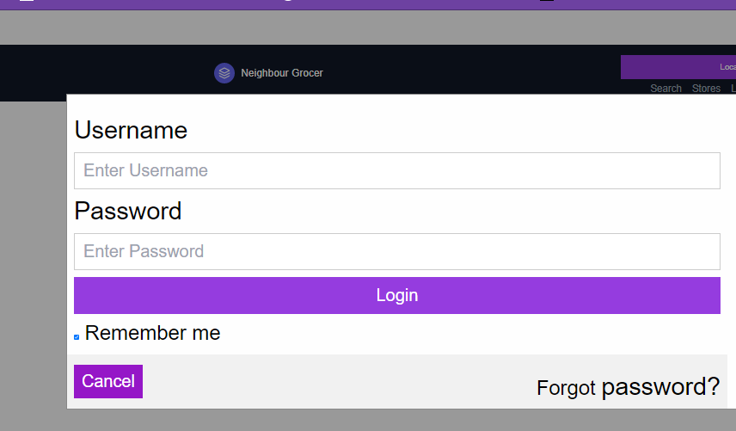
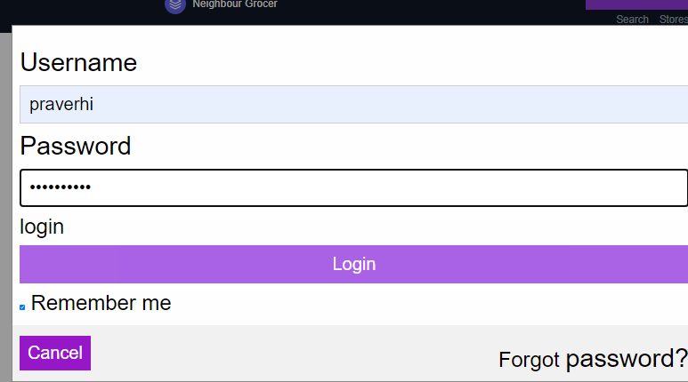
Sign in page

Slide 21
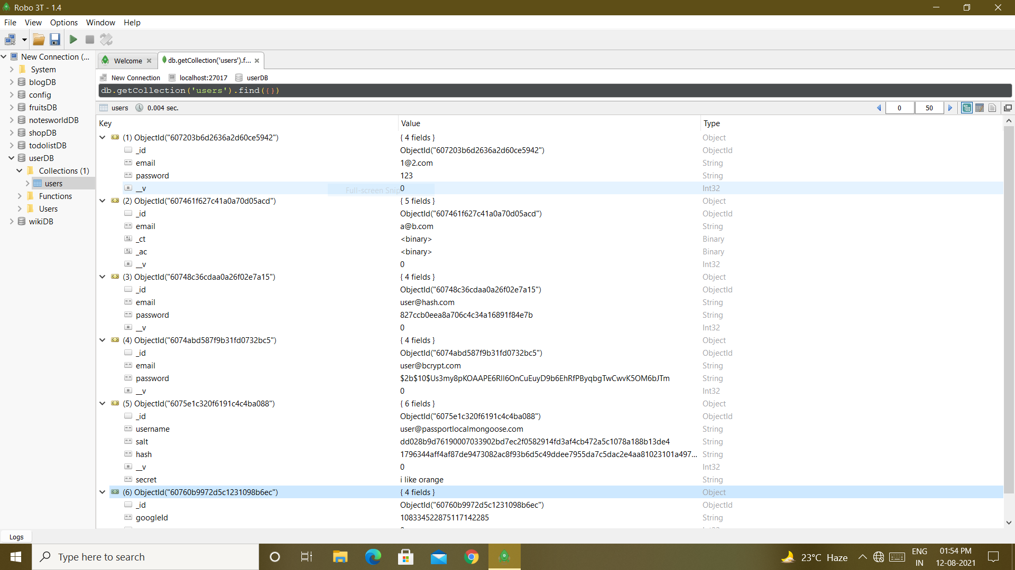
Database behind sign in

Slide 22
4. Mylist
This is one of main feature here user can make his grocery list and send it to shop owner directly.

Slide 23
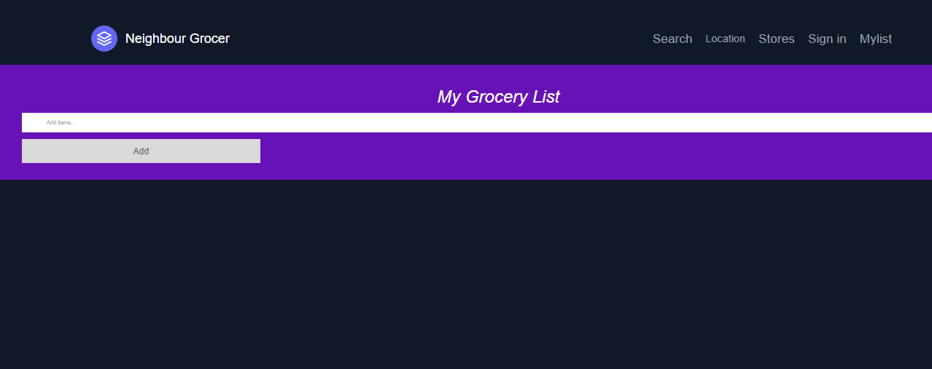
Mylist page

Slide 24
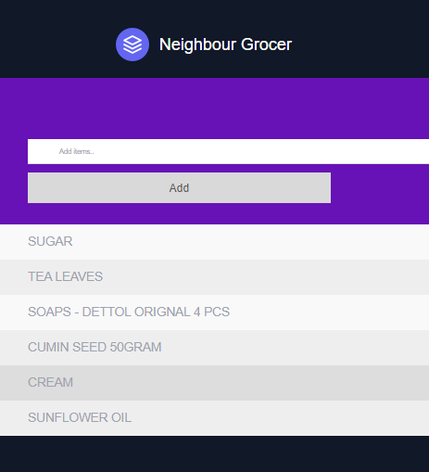
Mylist after adding items

Slide 25
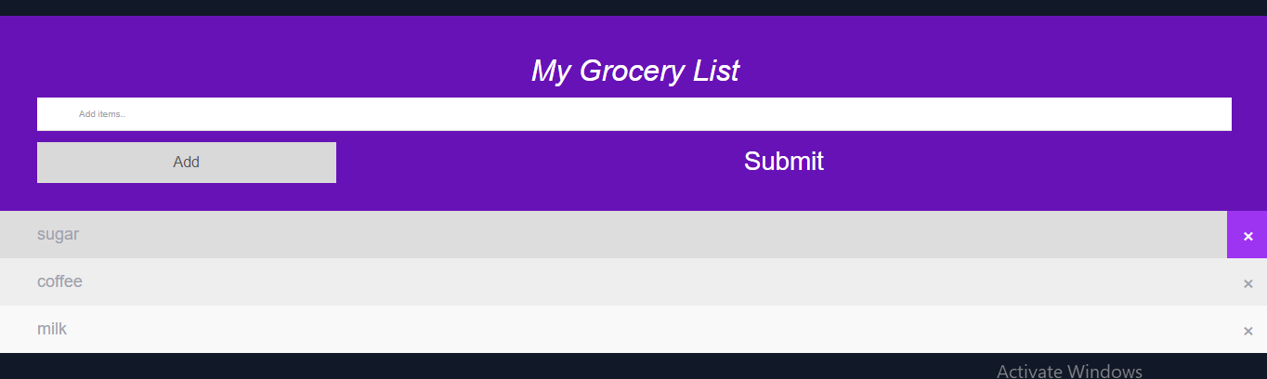
Submit your list

Slide 26
5. Search
Simply by going on search page user can search for shop he wants to buy product

Slide 27
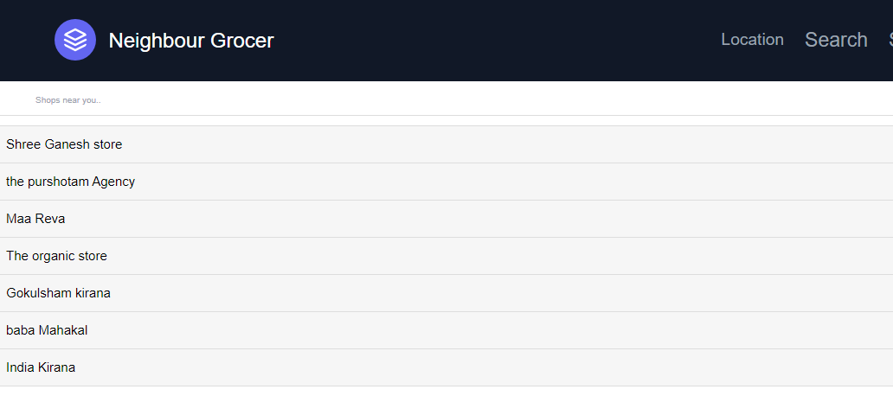
Search page

Slide 28
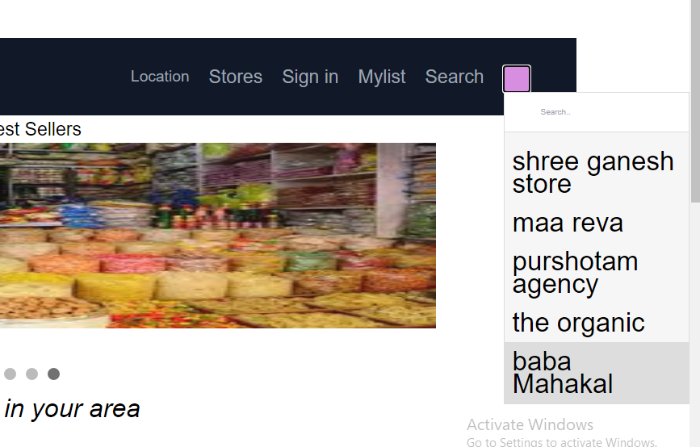

Slide 29
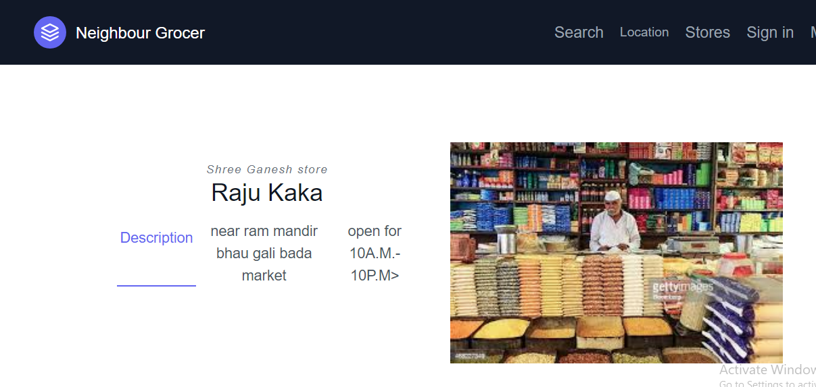

Slide 30
diagram to explain our ideas design
HOME PAGE
SEARCH
STORES
MYLIST
SIGN-IN
SHOP WANT TO VISIT
ORDER OR CALL
CREATE GROCERY LIST
SUBMIT YOUR LIST

Slide 31
SWOT Analysis
STRENGTHS
Being vocal for local is one the biggest strength of our website
WEAKNESSES
We can say site is not 100% complete yet nor it is going to be ever as review and updation is lifetime software process
S
W
As grocery is essential there are multiple opportunities to get connected with more and more shops
OPPORTUNITIES
Unexpected software internal error or fake user can damage user experience
THREATS
O
T

Slide 32


Thanks!
GROUP MEMBERS
PRAVERSHI MISHRA
PALKESH DHARMIK
KANCHAN PAL

